Slide 1
Homework #1 Feedback
Assumptions, assumptions, assumptions!
Be precise when defining sets, decision variables, and parameters.
Define the units for decision variables & parameters
Decimal representations 0.25 vs .25

Slide 2


Homework Discussion (1 of 7)
What’s the difference between these two formulations?
What does the objective function calculate?
Formulation #1
Formulation #2
Let $x_{j}≡$ the percentage of the new product comprised of compound $j=1,…,4$, where $20\%$ is $0.20$.
$$\begin{matrix}min & 20x_{1}+30x_{2}+20x_{3}+15x_{4} \\ s.t. & 0.35x_{1}+0.15x_{2}+0.35x_{3}+0.25x_{4}=0.25 \\ & 0.20x_{1}+0.65x_{2}+0.35x_{3}+0.40x_{4}≥0.35 \\ & 0.40x_{1}+0.15x_{2}+0.25x_{3}+0.30x_{4}≥0.20 \\ & x_{1}≤0.25 \\ & x_{2}≤0.35 \\ & x_{1}+x_{2}+x_{3}+x_{4}=1 \\ & x_{1},x_{2},x_{3},x_{4}≥0\end{matrix}$$
Let $x_{j}≡$ the percentage of the new product comprised of compound $j=1,…,4$, where $20\%$ is $0.20$.
$$\begin{matrix}min & 20x_{1}+30x_{2}+20x_{3}+15x_{4} \\ s.t. & 35x_{1}+15x_{2}+35x_{3}+25x_{4}=25 \\ & 20x_{1}+65x_{2}+35x_{3}+40x_{4}≥35 \\ & 40x_{1}+15x_{2}+25x_{3}+30x_{4}≥20 \\ & x_{1}≤0.25 \\ & x_{2}≤0.35 \\ & x_{1}+x_{2}+x_{3}+x_{4}=1 \\ & x_{1},x_{2},x_{3},x_{4}≥0\end{matrix}$$

Slide 3

Homework Discussion (2 of 7)
What’s wrong with this formulation?
Formulation #3
Let $x_{j}≡$ the percentage of the new product comprised of compound $j=1,…,4$, where $20\%$ is $0.20$.
$$\begin{matrix}min & 20x_{1}+30x_{2}+20x_{3}+15x_{4} \\ s.t. & 35x_{1}+15x_{2}+35x_{3}+25x_{4}=25 \\ & 20x_{1}+65x_{2}+35x_{3}+40x_{4}≥35 \\ & 40x_{1}+15x_{2}+25x_{3}+30x_{4}≥20 \\ & x_{1}≤25 \\ & x_{2}≤35 \\ & x_{1}+x_{2}+x_{3}+x_{4}=1 \\ & x_{1},x_{2},x_{3},x_{4}≥0\end{matrix}$$

Slide 4

Homework Discussion (3 of 7)
Notice that we’ve redefined our scale for “%”
What’s wrong with this formulation?
How could we fix it?
Formulation #4
Let $x_{j}≡$ the percentage of the new product comprised of compound $j=1,…,4$, where $20\%$ is $20$.
$$\begin{matrix}min & 20x_{1}+30x_{2}+20x_{3}+15x_{4} \\ s.t. & 35x_{1}+15x_{2}+35x_{3}+25x_{4}=25 \\ & 20x_{1}+65x_{2}+35x_{3}+40x_{4}≥35 \\ & 40x_{1}+15x_{2}+25x_{3}+30x_{4}≥20 \\ & x_{1}≤25 \\ & x_{2}≤35 \\ & x_{1}+x_{2}+x_{3}+x_{4}=100 \\ & x_{1},x_{2},x_{3},x_{4}≥0\end{matrix}$$

Slide 5

Homework Discussion (4 of 7)
Have we fixed the problem?
What does the objective function now measure?
Is this OK?
Formulation #5
Let $x_{j}≡$ the percentage of the new product comprised of compound $j=1,…,4$, where $20\%$ is $20$.
$$\begin{matrix}min & 20x_{1}+30x_{2}+20x_{3}+15x_{4} \\ s.t. & 0.35x_{1}+0.15x_{2}+0.35x_{3}+0.25x_{4}=25 \\ & 0.20x_{1}+0.65x_{2}+0.35x_{3}+0.40x_{4}≥35 \\ & 0.40x_{1}+0.15x_{2}+0.25x_{3}+0.30x_{4}≥20 \\ & x_{1}≤25 \\ & x_{2}≤35 \\ & x_{1}+x_{2}+x_{3}+x_{4}=100 \\ & x_{1},x_{2},x_{3},x_{4}≥0\end{matrix}$$

Slide 6

Homework Discussion (5 of 7)
Is this formulation valid?
What does the objective function now measure?
Is this OK?
Formulation #6
Let $x_{j}≡$ the amount (in kg) of compound $j=1,…,4$, in 1 kg of the new product
$$\begin{matrix}min & 20x_{1}+30x_{2}+20x_{3}+15x_{4} \\ s.t. & 0.35x_{1}+0.15x_{2}+0.35x_{3}+0.25x_{4}=0.25 \\ & 0.20x_{1}+0.65x_{2}+0.35x_{3}+0.40x_{4}≥0.35 \\ & 0.40x_{1}+0.15x_{2}+0.25x_{3}+0.30x_{4}≥0.20 \\ & x_{1}≤0.25 \\ & x_{2}≤0.35 \\ & x_{1}+x_{2}+x_{3}+x_{4}=1 \\ & x_{1},x_{2},x_{3},x_{4}≥0\end{matrix}$$

Slide 7

Homework Discussion (6 of 7)
Is this formulation valid?
What does the objective function now measure?
Formulation #7
Let $x_{j}≡$ the amount (in kg) of compound $j=1,…,4$, in $b>0$ kg of the new product
$$\begin{matrix}min & 20x_{1}+30x_{2}+20x_{3}+15x_{4} \\ s.t. & 0.35x_{1}+0.15x_{2}+0.35x_{3}+0.25x_{4}=0.25b \\ & 0.20x_{1}+0.65x_{2}+0.35x_{3}+0.40x_{4}≥0.35b \\ & 0.40x_{1}+0.15x_{2}+0.25x_{3}+0.30x_{4}≥0.20b \\ & x_{1}≤0.25b \\ & x_{2}≤0.35b \\ & x_{1}+x_{2}+x_{3}+x_{4}=b \\ & x_{1},x_{2},x_{3},x_{4}≥0\end{matrix}$$

Slide 8

Homework Discussion (7 of 7)
Is this formulation valid?
What does the objective function now measure?
What is it’s value at optimality?
Formulation #8
Let $x_{j}≡$ the amount (in kg) of compound $j=1,…,4$, in the new product
$$\begin{matrix}min & 20x_{1}+30x_{2}+20x_{3}+15x_{4} \\ s.t. & 0.35x_{1}+0.15x_{2}+0.35x_{3}+0.25x_{4}=0.25\left(x_{1}+x_{2}+x_{3}+x_{4}\right) \\ & 0.20x_{1}+0.65x_{2}+0.35x_{3}+0.40x_{4}≥0.35\left(x_{1}+x_{2}+x_{3}+x_{4}\right) \\ & 0.40x_{1}+0.15x_{2}+0.25x_{3}+0.30x_{4}≥0.20\left(x_{1}+x_{2}+x_{3}+x_{4}\right) \\ & x_{1}≤0.25\left(x_{1}+x_{2}+x_{3}+x_{4}\right) \\ & x_{2}≤0.35\left(x_{1}+x_{2}+x_{3}+x_{4}\right) \\ & x_{1},x_{2},x_{3},x_{4}≥0\end{matrix}$$

Slide 9
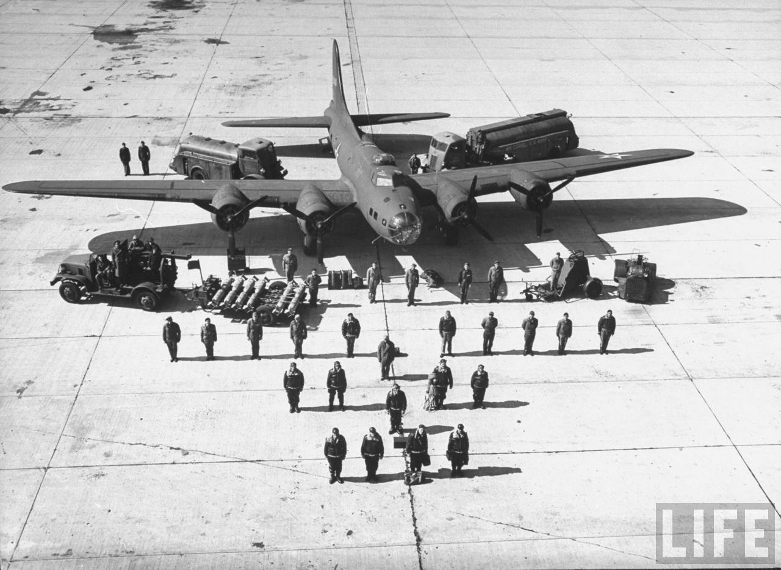
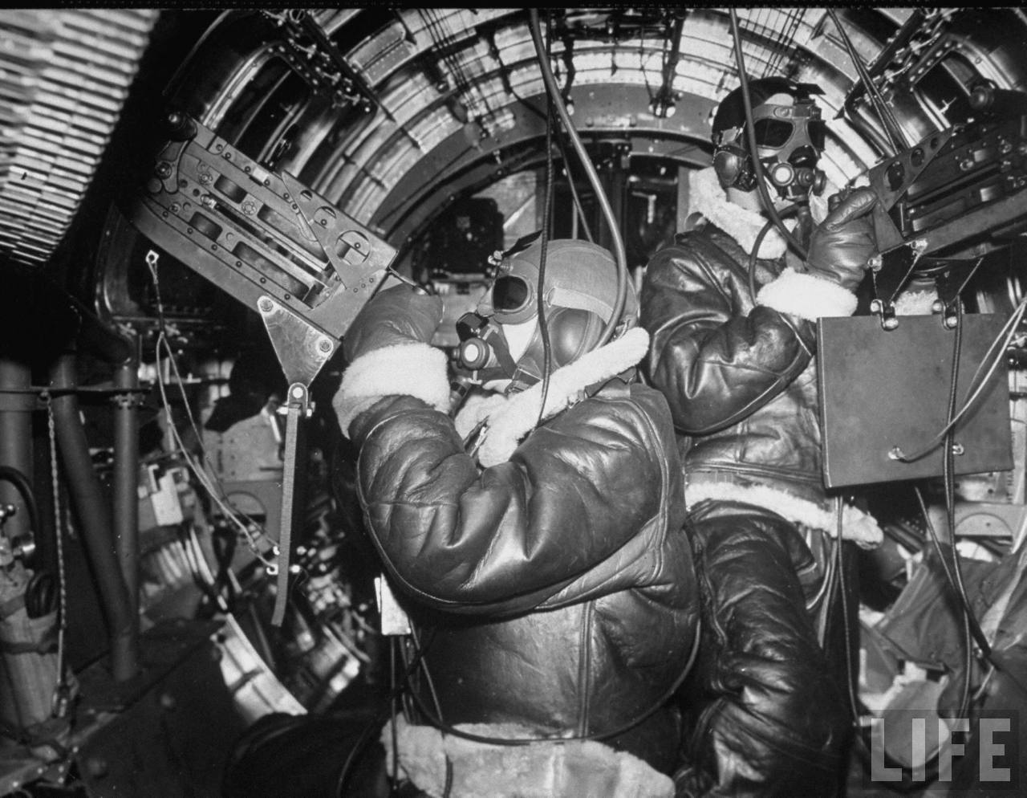

Slide 10
OPER 610 Lesson 03 Linear Algebra, Convex Analysis, and Polyhedral Sets
Dr Brian J. Lunday
Office: Rm 201E, Bldg 641

Slide 11
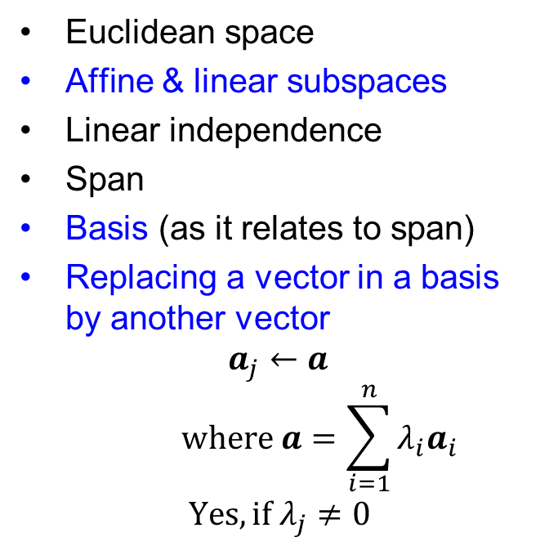
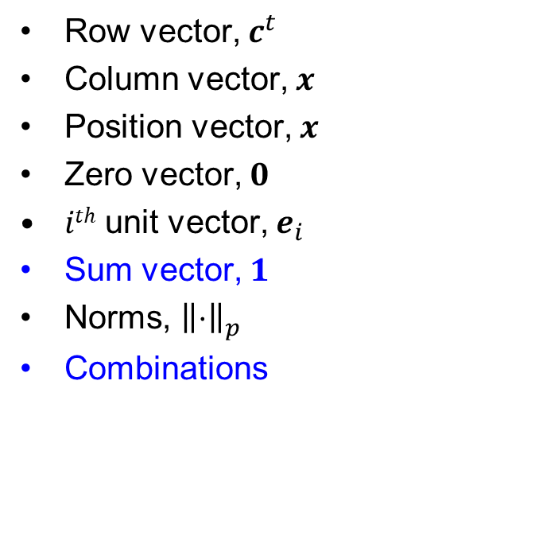
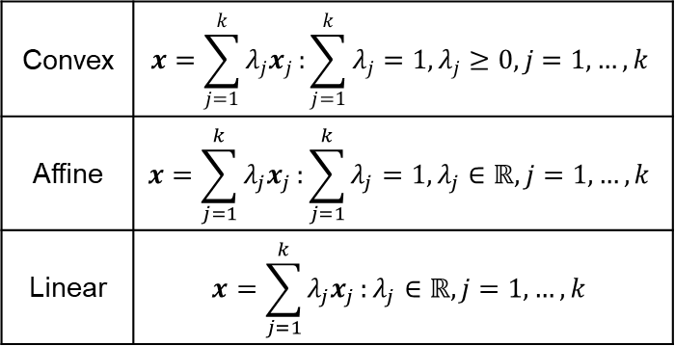
Vectors
Row vector, $c^{t}$
Column vector, $x$
Position vector, $x$
Zero vector, $0$
$ith$ unit vector, $e_{i}$
Sum vector, $1$
Norms, ${\left\|⋅\right\|}_{p}$
Combinations
Euclidean space
Affine & linear subspaces
Linear independence
Span
Basis (as it relates to span)
Replacing a vector in a basis by another vector
$$a_{j}←a$$
$$where a=\sum_{i=1}^{n}{λ_{i}a_{i}}$$
$$Yes, if λ_{j}≠0$$
Convex | $$x=\sum_{j=1}^{k}{λ_{j}x_{j}}:\sum_{j=1}^{k}{λ_{j}}=1,λ_{j}≥0,j=1,…,k$$
Affine | $$x=\sum_{j=1}^{k}{λ_{j}x_{j}}:\sum_{j=1}^{k}{λ_{j}}=1,λ_{j}∈ℝ,j=1,…,k$$
Linear | $$x=\sum_{j=1}^{k}{λ_{j}x_{j}}:λ_{j}∈ℝ,j=1,…,k$$

Slide 12
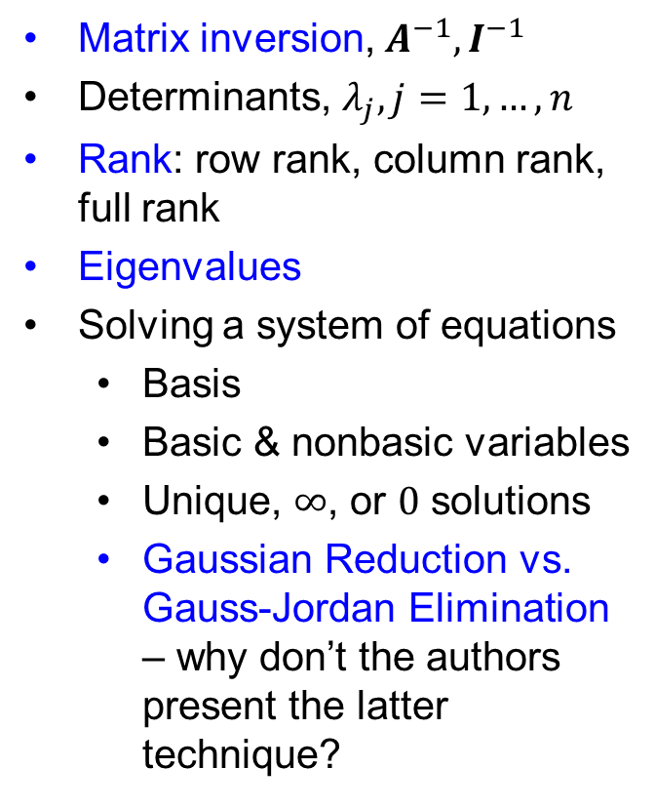
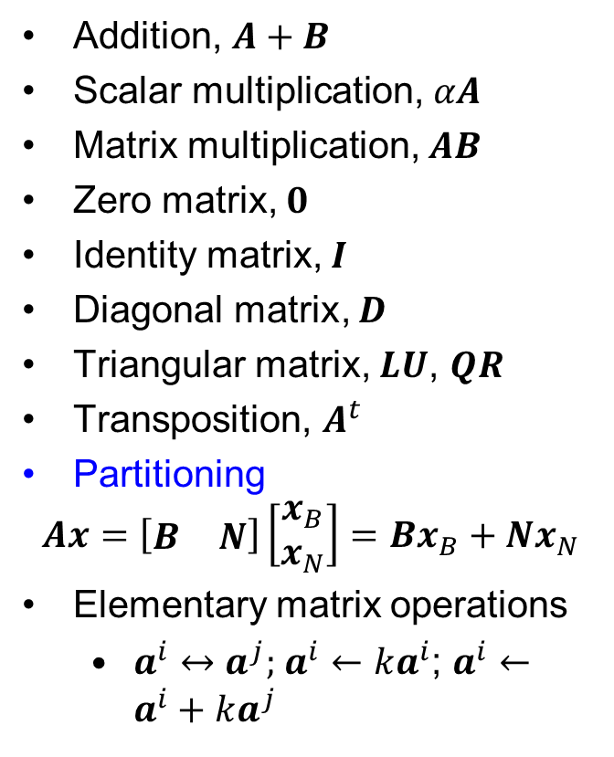
Matrices
Addition, $A+B$
Scalar multiplication, $αA$
Matrix multiplication, $AB$
Zero matrix, $0$
Identity matrix, $I$
Diagonal matrix, $D$
Triangular matrix, $LU$, $QR$
Transposition, $A^{t}$
Partitioning
$$Ax=\left[\begin{matrix}B & N\end{matrix}\right]\left[\begin{matrix}x_{B} \\ x_{N}\end{matrix}\right]=Bx_{B}+Nx_{N}$$
Elementary matrix operations
$a^{i}↔a^{j}$; $a^{i}←ka^{i}$; $a^{i}←a^{i}+ka^{j}$
Matrix inversion, $A^{−1}, I^{−1}$
Determinants, $λ_{j},j=1,…,n$
Rank: row rank, column rank, full rank
Eigenvalues
Solving a system of equations
Basis
Basic & nonbasic variables
Unique, $∞$, or $0$ solutions
Gaussian Reduction vs. Gauss-Jordan Elimination – why don’t the authors present the latter technique?

Slide 13
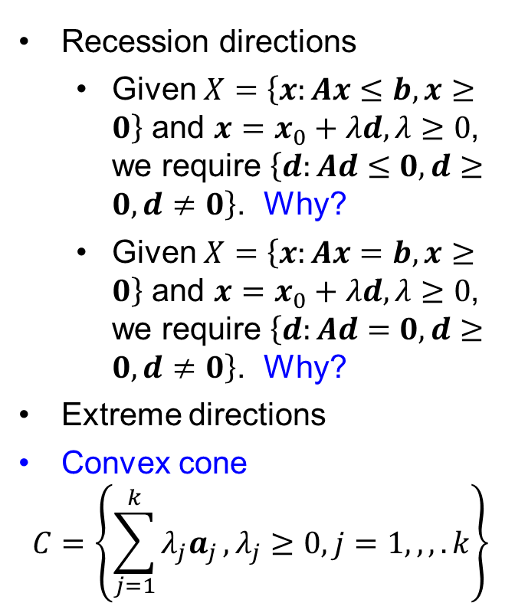
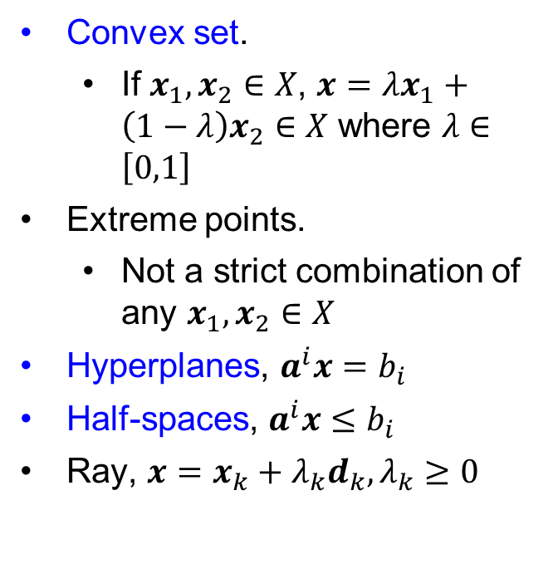
Convex Sets
Convex set.
If $x_{1},x_{2}∈X$, $x=λx_{1}+\left(1−λ\right)x_{2}∈X$ where $λ∈\left[0,1\right]$
Extreme points.
Not a strict combination of any $x_{1},x_{2}∈X$
Hyperplanes, $a^{i}x=b_{i}$
Half-spaces, $a^{i}x≤b_{i}$
Ray, $x=x_{k}+λ_{k}d_{k}, λ_{k}≥0$
Recession directions
Given $X=\left\{x:Ax≤b,x≥0\right\}$ and $x=x_{0}+λd, λ≥0$, we require $\left\{d:Ad≤0,d≥0,d≠0\right\}$. Why?
Given $X=\left\{x:Ax=b,x≥0\right\}$ and $x=x_{0}+λd, λ≥0$, we require $\left\{d:Ad=0,d≥0,d≠0\right\}$. Why?
Extreme directions
Convex cone
$$C=\left\{\sum_{j=1}^{k}{λ_{j}a_{j}}, λ_{j}≥0,j=1,,,.k\right\}$$

Slide 14
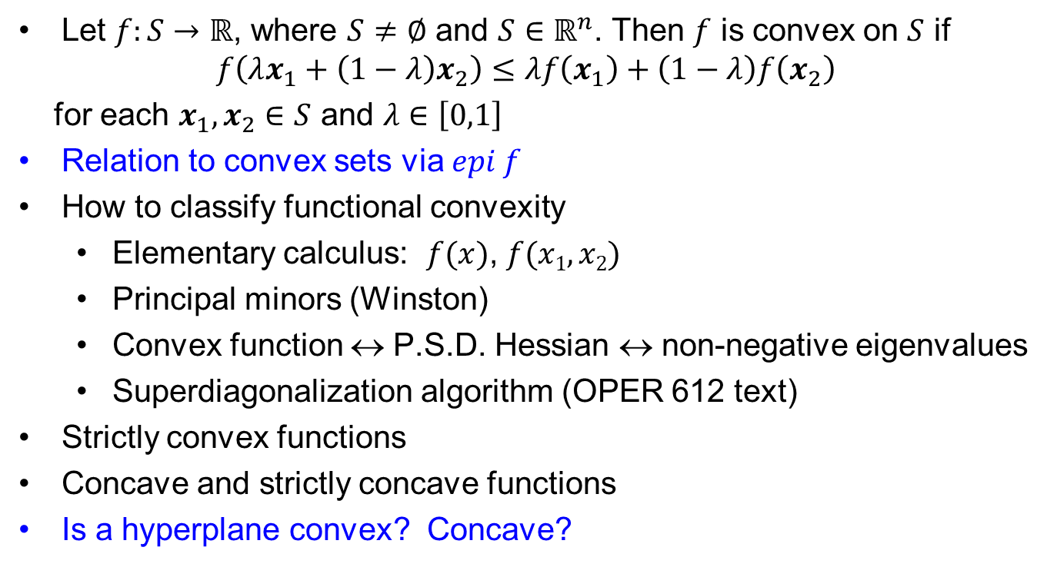
Convex Functions
Let $f:S→ℝ$, where $S≠∅$ and $S∈ℝ^{n}$. Then $f$ is convex on $S$ if
$$f\left(λx_{1}+\left(1−λ\right)x_{2}\right)≤λf\left(x_{1}\right)+\left(1−λ\right)f\left(x_{2}\right)$$
for each $x_{1},x_{2}∈S$ and $λ∈\left[0,1\right]$
Relation to convex sets via $epi f$
How to classify functional convexity
Elementary calculus: $f(x)$, $f(x1,x2)$
Principal minors (Winston)
Convex function ↔ P.S.D. Hessian ↔ non-negative eigenvalues
Superdiagonalization algorithm (OPER 612 text)
Strictly convex functions
Concave and strictly concave functions
Is a hyperplane convex? Concave?

Slide 15
Polyhedral Sets & Cones
Polyhedral Set / Polyhedron
Intersection of a finite number of half-spaces
Polytope
Bounded polyhedral set
Polyhedral Cone
Polyhedron with intersection at 0

Slide 16
Extreme Points
Definition
Binding/active/tight constraints
Non-binding constraints
Redundant constraints
Defining hyperplanes
Extreme point ↔ corner point ↔ vertex
Degenerate extreme point
Order of degeneracy
Degenerate polyhedral set

Slide 17
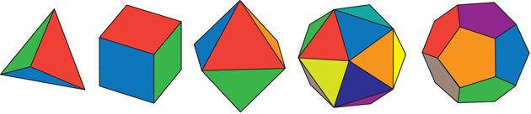

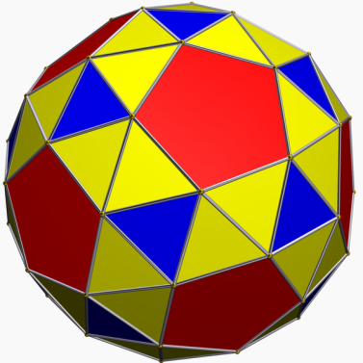
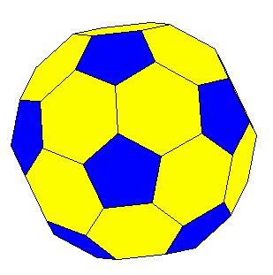
Degeneracy
Which of these polytopes have degenerate extreme points?
What is their order of degeneracy?

Slide 18
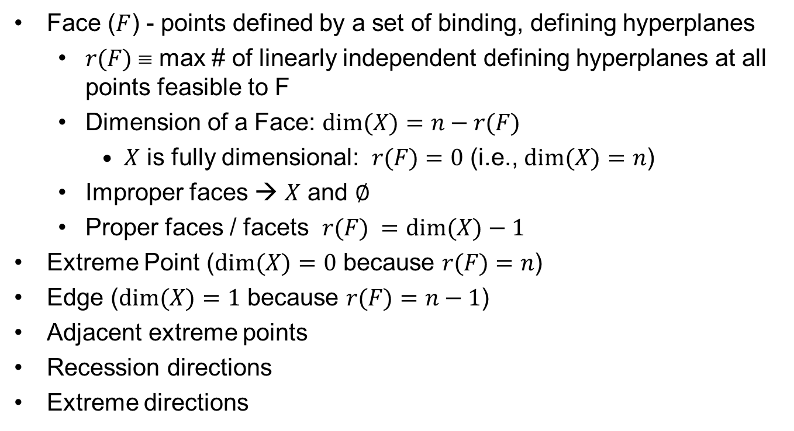
Surface Geometry of Polyhedral Sets
Face ($F$) - points defined by a set of binding, defining hyperplanes
$r(F)$ ≡ max # of linearly independent defining hyperplanes at all points feasible to F
Dimension of a Face: $dim⁡(X)=n−r(F)$
$X$ is fully dimensional: $r(F)=0$ (i.e., $dim⁡(X)=n$)
Improper faces → $X$ and $∅$
Proper faces / facets $r(F) =dim⁡(X)−1$
Extreme Point ($dim⁡(X)=0$ because $r(F)=n$)
Edge ($dim⁡(X)=1$ because $r(F)=n−1$)
Adjacent extreme points
Recession directions
Extreme directions

Slide 19
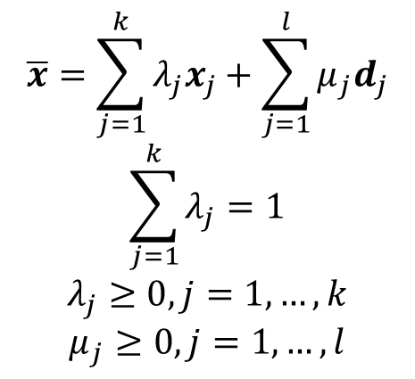
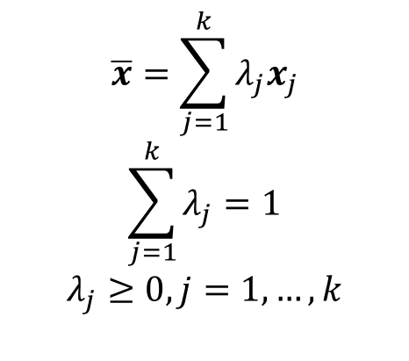
Representation of Feasible Regions via EPs & EDs
$$X=\left\{x:Ax≤b,x≥0\right\}$$
bounded polyhedral set
(i.e., a polytope)
unbounded polyhedral set
$$\overline{x}=\sum_{j=1}^{k}{λ_{j}x_{j}}$$
$$\sum_{j=1}^{k}{λ_{j}}=1$$
$$λ_{j}≥0,j=1,…,k$$
$$\overline{x}=\sum_{j=1}^{k}{λ_{j}x_{j}}+\sum_{j=1}^{l}{μ_{j}d_{j}}$$
$$\sum_{j=1}^{k}{λ_{j}}=1$$
$$λ_{j}≥0,j=1,…,k$$
$$μ_{j}≥0,j=1,…,l$$

Slide 20
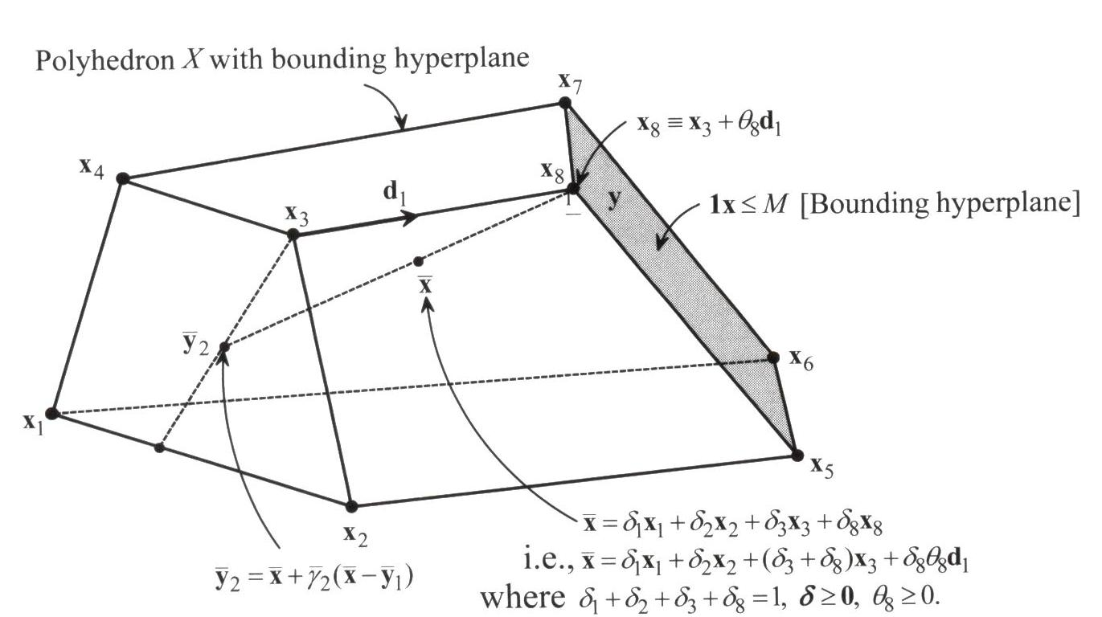

Theorem 2.1 & Figure 2.19 Discussion
What are the authors illustrating with this diagram?
What’s the significance of the figure?
Expectations for reading proofs
What’s being proven – statement or contrapositive
Type of proof – direct, induction, contradiction, etc.
$${\overline{y}}_{1}$$

Slide 21
Questions & Discussion

Slide 22
For next class
Complete the tutorial as posted on Canvas

Slide 23
For next (regular) class
Sections 3.1-3.6
Supplemental readings on Canvas
Dantzig, G. B. (1983). Reminiscences about the origins of linear programming. In Mathematical Programming The State of the Art (pp. 78-86). Springer, Berlin, Heidelberg.
Homework #3: Problem 1.2 (Phase 2)
Include your manual formulation from Phase 1, updated and/or corrected as appropriate
Model the compact formulation in GAMS to leverage the indices on decision variables and constraints to write a shorter (denser) formulation

